Slide 1
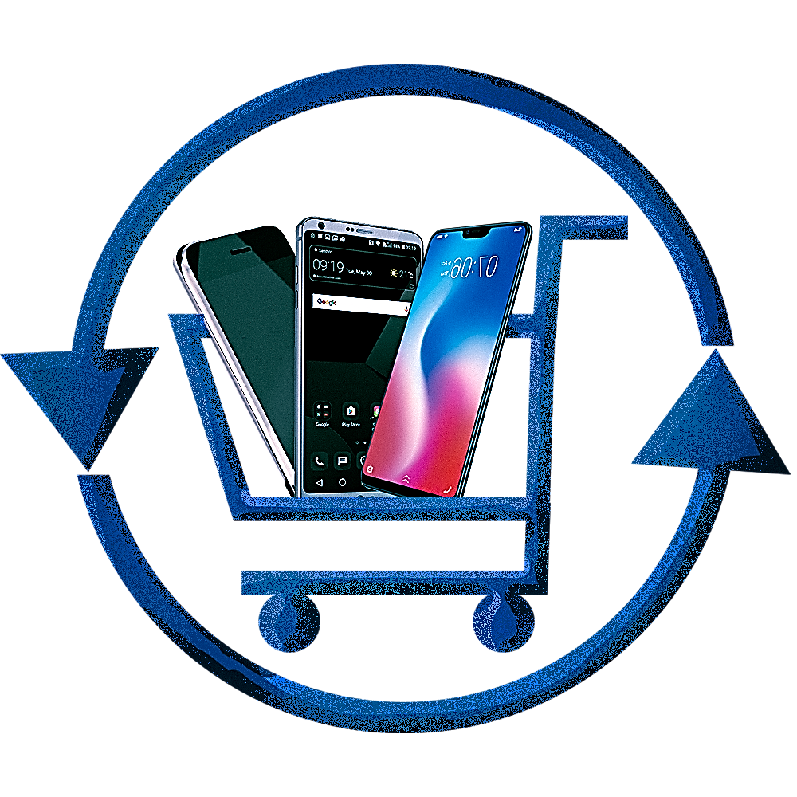
Welcome

Slide 2
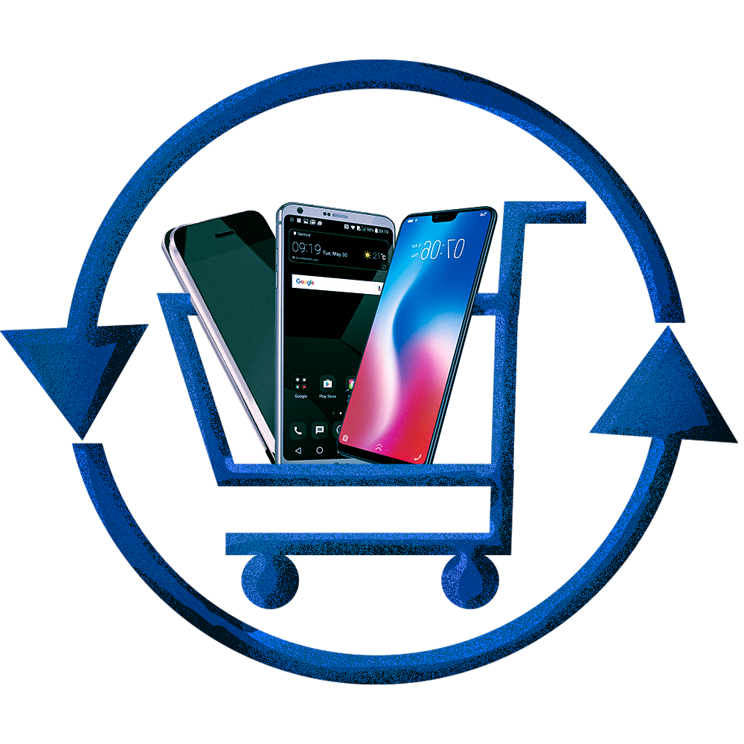
Refone store
E-commerce App
Samundra Khanal (21707/075)
Tufan Bhandari (21724/075)
Prabesh Mishra (21686/075)

Slide 3

Introduction
Refone store is an e-commerce app from where people
can buy and sell second-hand mobiles online.
Refone store is built on Kotlin for Android platform.
A user is itself a buyer and a seller.
Refone store is based on COD (Cash on Delivery) payment
system.

Slide 4

Why Refone Store?
Mobiles Phones are an essential part of Human lives, but for some it is only a dream because they can’t afford them.
And, for some it keeps getting accumulated due to technological advancements and evolving personal preferences.

Slide 5

objective
Effortless smartphone buying and selling.
Easy smartphone access for local users.
Community building through app.
Available of smartphone at cheaper price.

Slide 6




Tools and platform
Android Studio (as a IDE)
Kotlin (as a programming language / Frontend)
XML (as a defining layout)
Firebase (as a backend and a database)

Slide 7
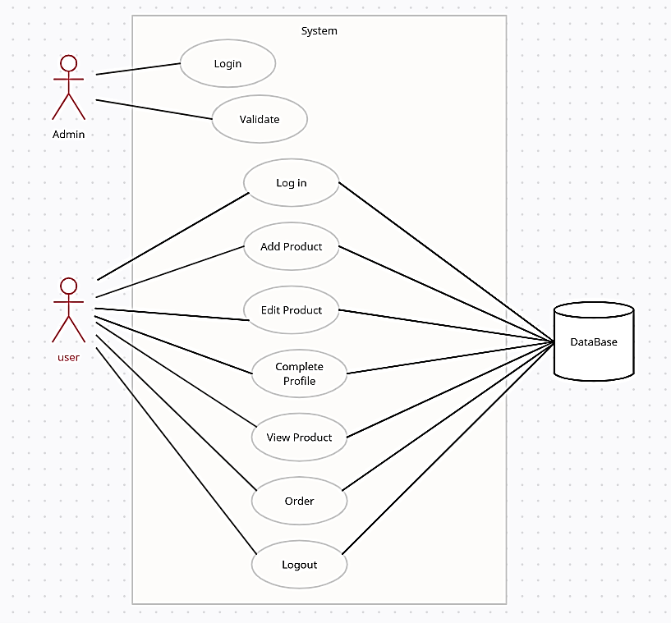
Use case diagram
Graphical Representation of a functional requirements…….

Slide 8
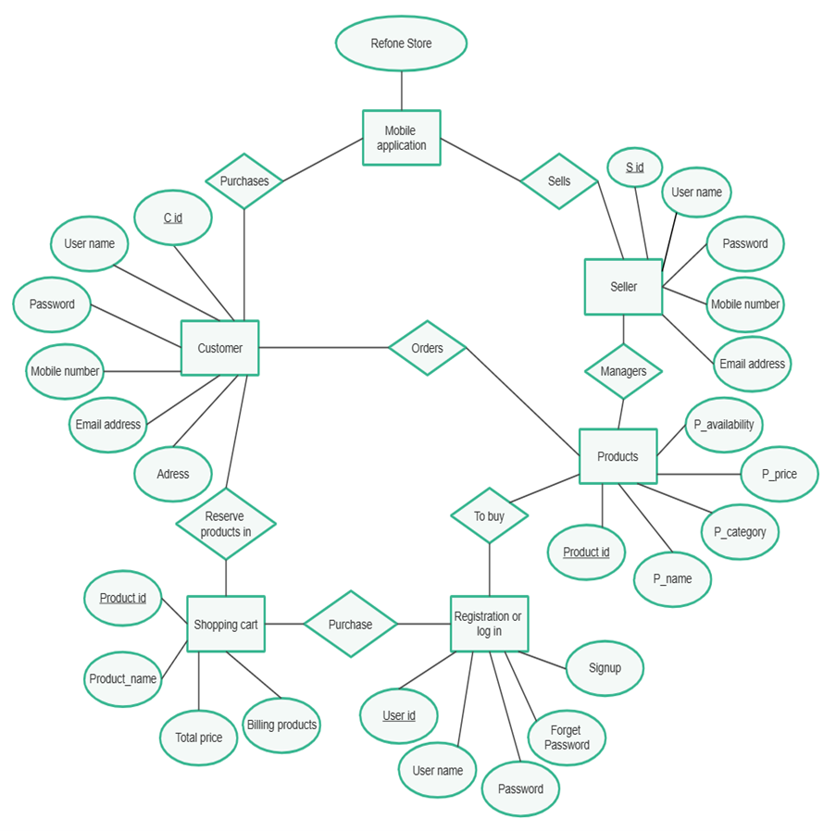
Er diagram
Visual representations of objects or concepts within the system…

Slide 9
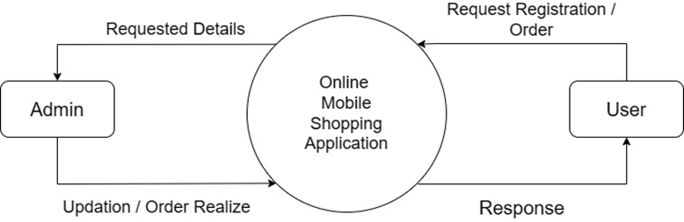
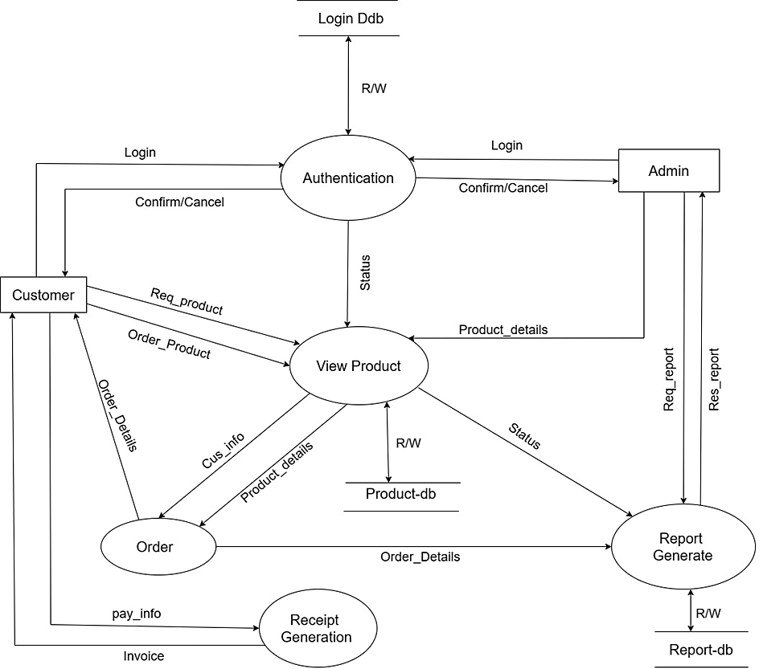
DFD
Level 0 DFD
Graphical Representations of function or process which capture, manipulate, store and distribute data between a system and its environment and between components of a system…
Level 1 DFD

Slide 10
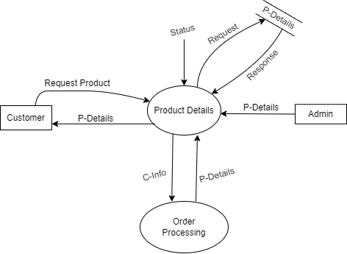
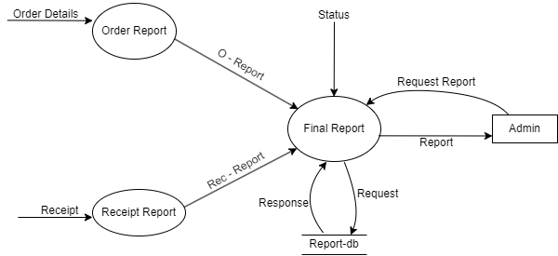
DFD
Level 2 DFD (View Product)
Level 2 DFD (Report Generate)

Slide 11
Future Plan
We are thinking of some modifications and adding some advanced new features in our system .
Some of them are:-
* Adding more Payment Gateway such as QR menu, Khalti, E-Sewa etc.
* User can review the Product.
* Adding KYC form for the user.

Slide 12
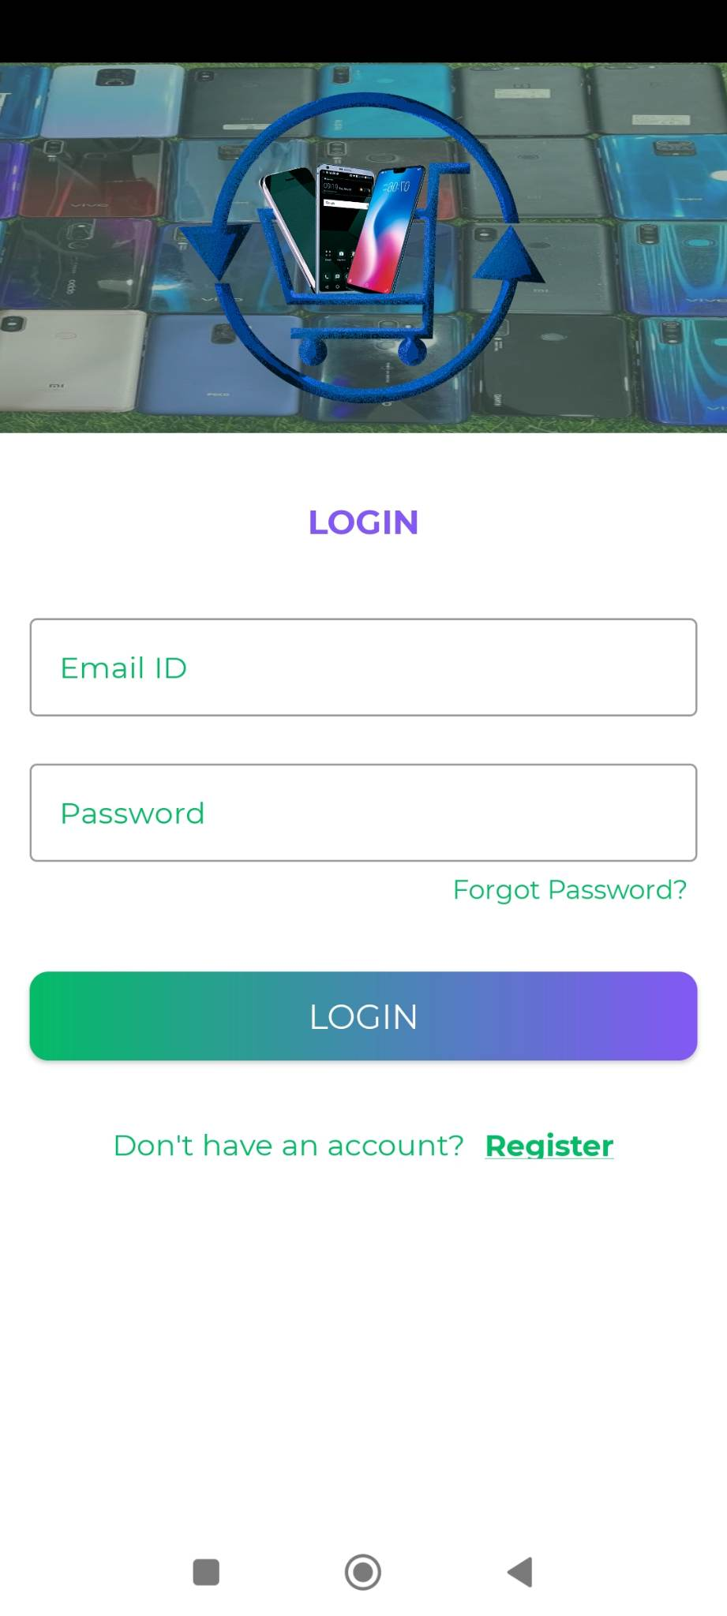
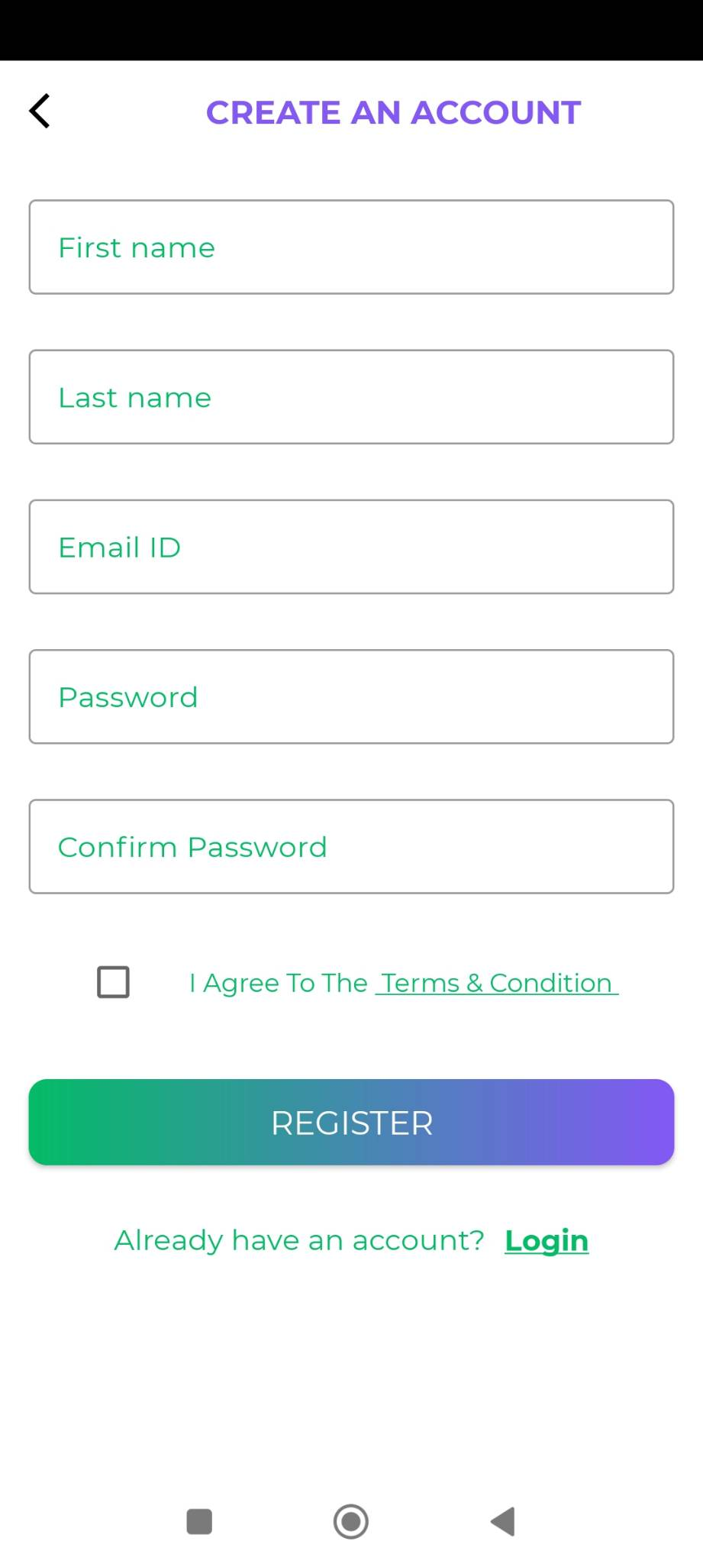
login
Register

Slide 13
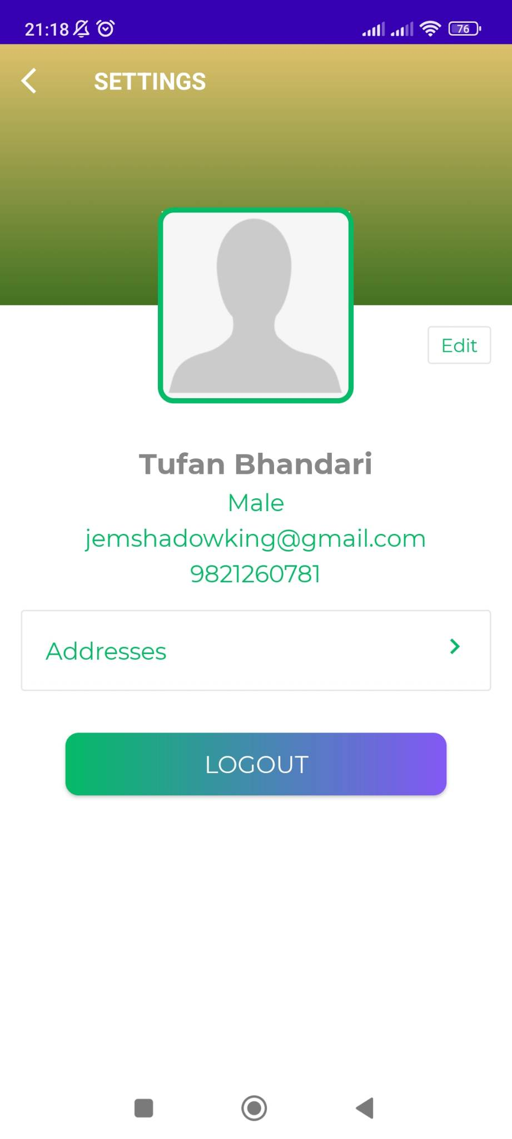
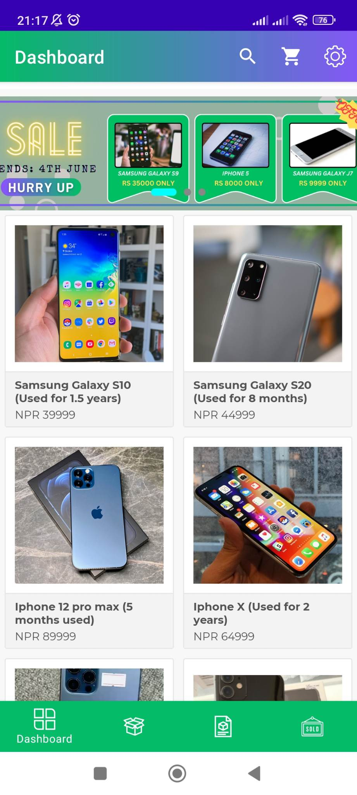
profile
Dashboard

Slide 14
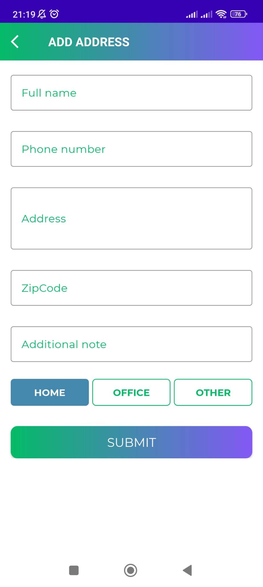
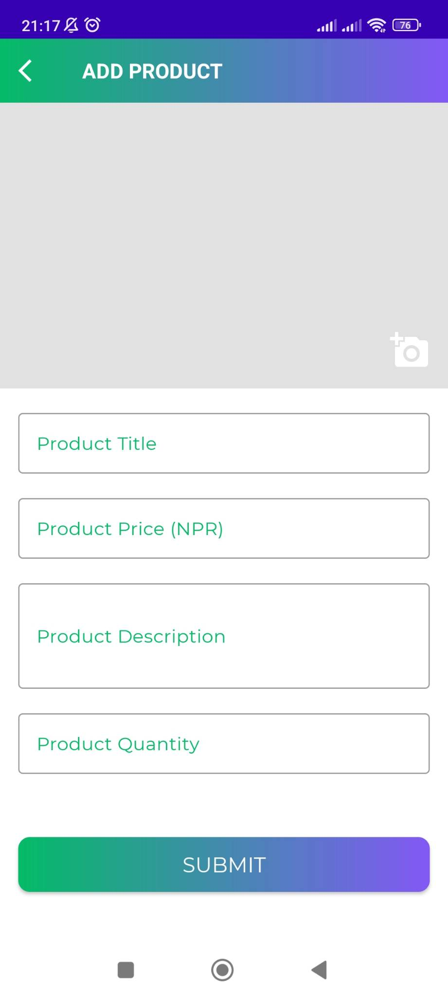
Add Address
Add product

Slide 15
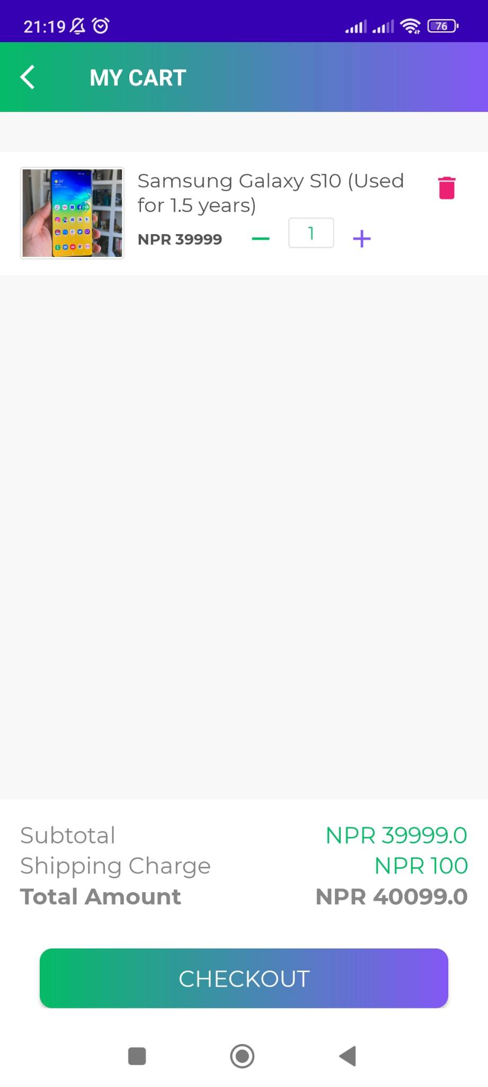
My cart

Slide 16
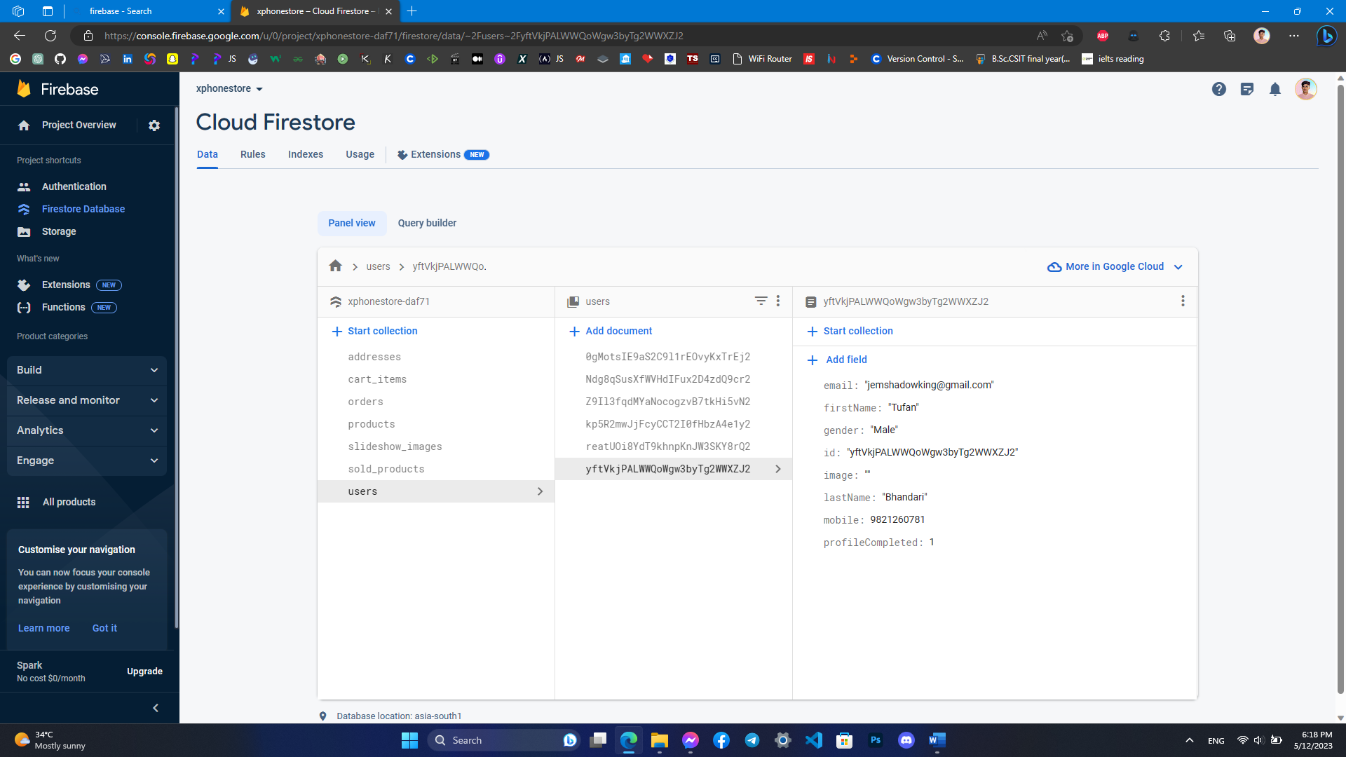
database

Slide 17
Live demo of the project

Slide 18
THANK YOU

